Slide 1
Minimal basics regarding power spectra
Amr El-Zant

Slide 2
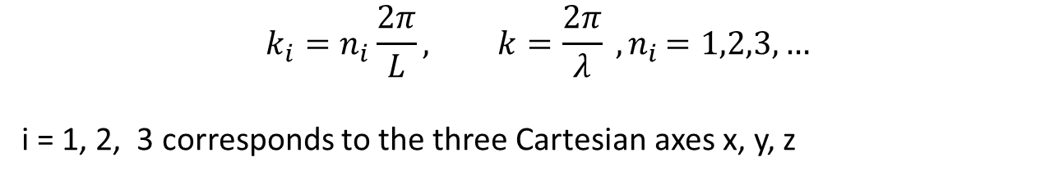
Series Expansion
Fourier: A powerful method of analyzing fields on different scales
Modes
If a field F (x) – i.e. a scalar function of x = (x, y, z) --- is a periodic function inside cube with length L, you can expand
(cf. brief intro in https://mathworld.wolfram.com/FourierSeries.html )
$$k_{i}=n_{i}\frac{2π}{L}, k=\frac{2π}{λ} {, n}_{i}=1,2,3, …$$
i = 1, 2, 3 corresponds to the three Cartesian axes x, y, z

Slide 3
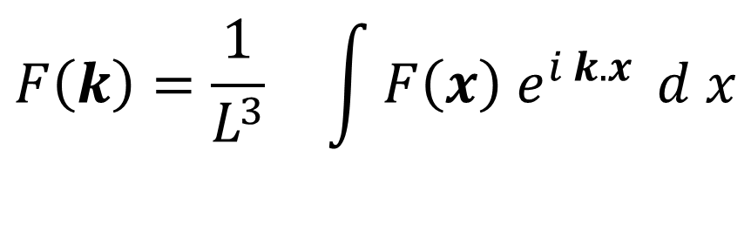
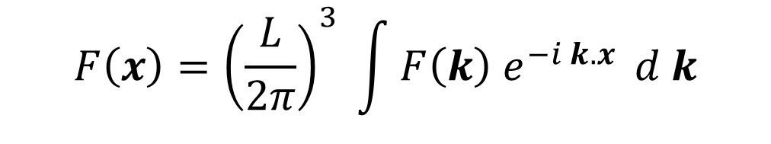
Tending to the continuum limit
Let the box size L increase indefinitely
→ Number modes increases arbitrarily → k values become closely spaced
Continuity (Riemann integral):
$$F\left(x\right)={\left(\frac{L}{2π}\right)}^{3} \int{F\left(k\right){ e}^{−i k.x} }d k$$
$$F\left(k\right)=\frac{1}{L^{3}} \int{F\left(x\right){ e}^{i k.x} }d x$$

Slide 4
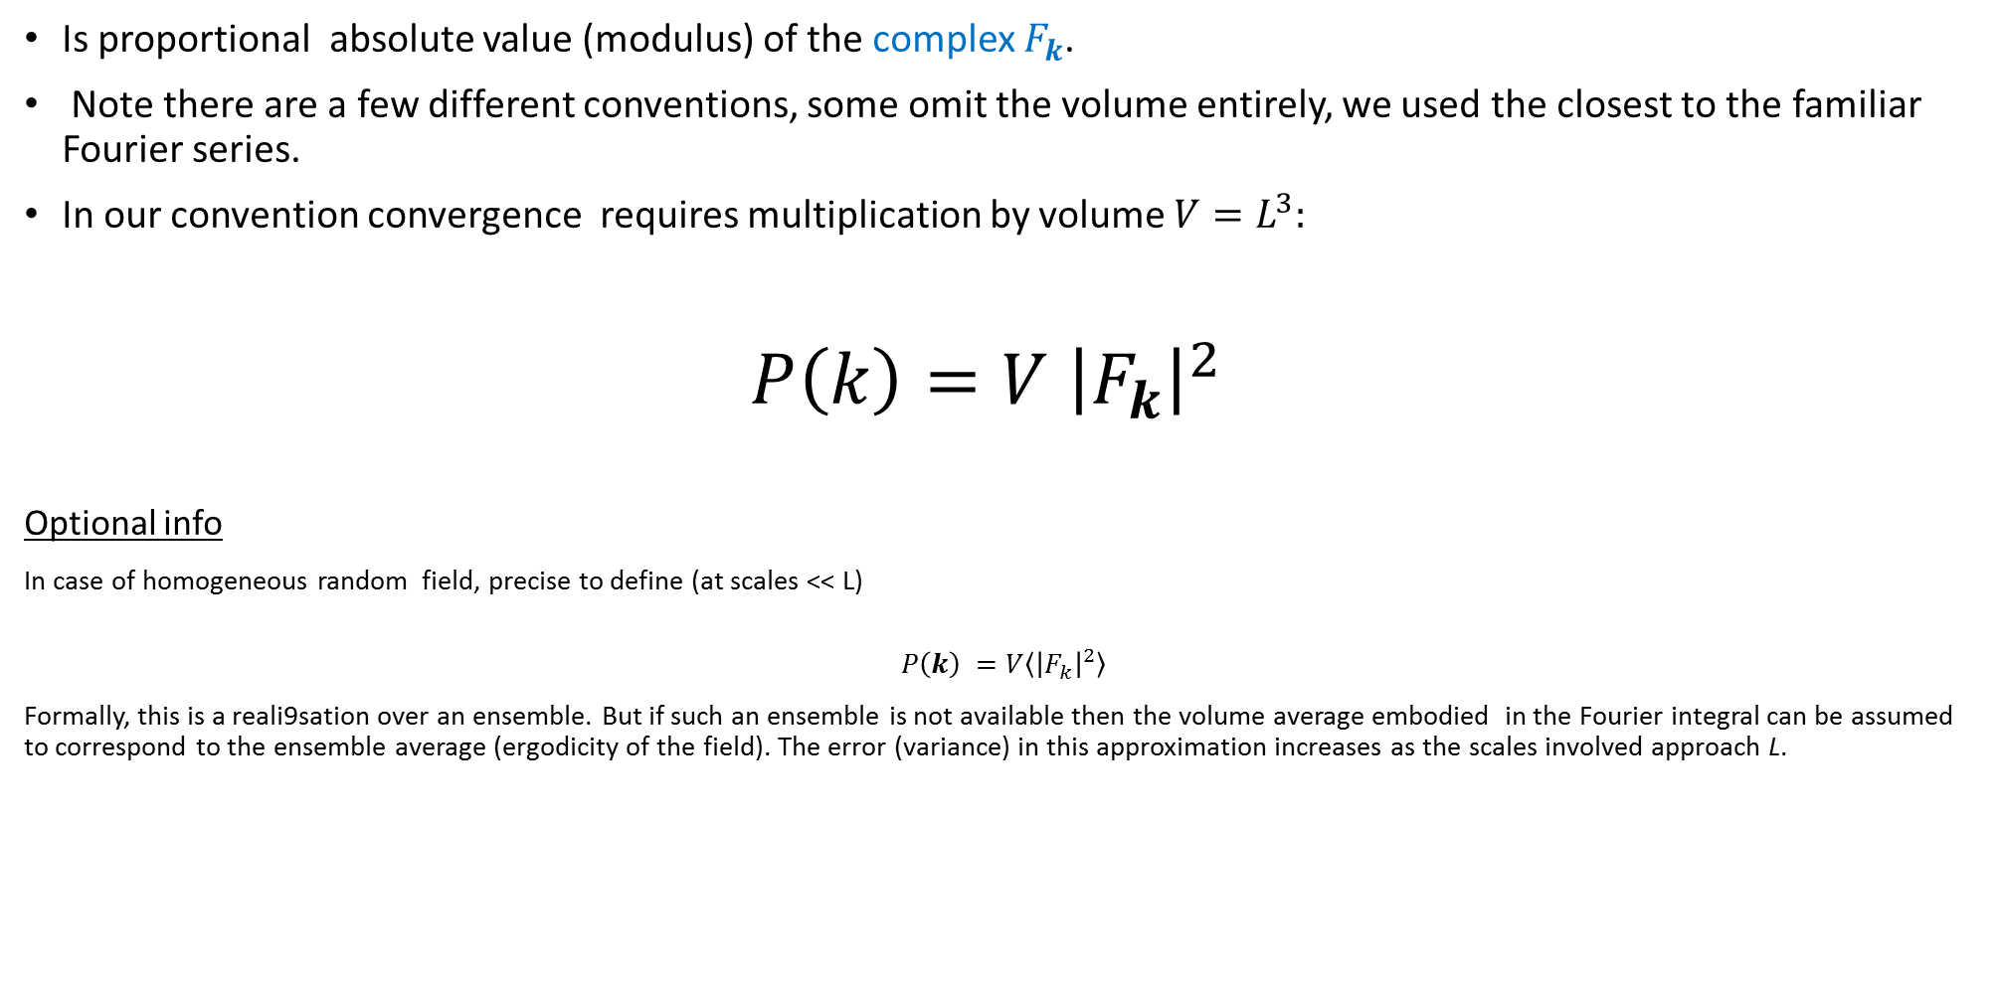
The Power Spectrum P (k)
Is proportional absolute value (modulus) of the complex $F_{k}$.
Note there are a few different conventions, some omit the volume entirely, we used the closest to the familiar Fourier series.
In our convention convergence requires multiplication by volume $V=L^{3}:$
$P\left(k\right)=V {\left|F_{k}\right|}^{2}$
Optional info
In case of homogeneous random field, precise to define (at scales << L)
$$P\left(k\right) =V\left\langle {\left|F_{k}\right|}^{2}\right\rangle$$
Formally, this is a reali9sation over an ensemble. But if such an ensemble is not available then the volume average embodied in the Fourier integral can be assumed to correspond to the ensemble average (ergodicity of the field). The error (variance) in this approximation increases as the scales involved approach L.

Slide 5
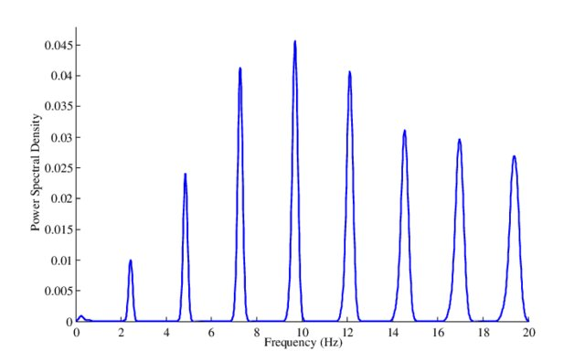
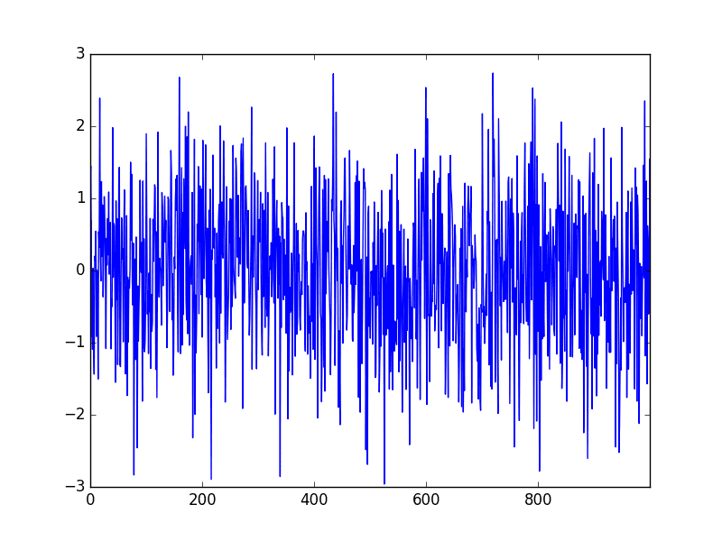

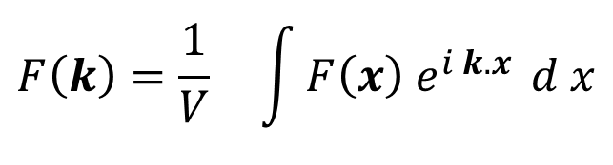
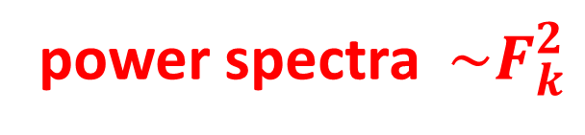
Sum up ++ Couple Examples
Fourier: A powerful method of analyzing fields on different scales
If a field F is periodic in L you can expand
Cardiogram → Periodic Signal
Menames et. al. 2002
$$k_{i}=n_{i}\frac{2π}{L} k=\frac{2π}{λ}$$
$$F\left(k\right)=\frac{1}{V} \int{F\left(x\right){ e}^{i k.x} }d x$$
White noise → Flat
power spectra ${\sim F}_{k}^{2}$
Frequency →
Time

